Slide 1
Jacob Summer Update IV
Experimental Setup

Slide 2
Where we’re at
Validate/improve simulation with experiments
Design experimental setup to capture:
Forces (load cell)
Jump height (cameras)
Power consumption (V/I sensor)

Slide 3
Literature – R.S. Fearing
Power Modulation and Optimization

Slide 4
Simulation MATLAB
Moment arm vs jump height with
100 rpm motor --> 1.02m moment arm and 1.447m jump height
300 rpm motor --> .182m moment arm and .519m jump height
Motor internal gear ratio vs jump height with
.05m moment arm --> 668 rpm and .2995m
.1m moment arm --> 432 rpm and .358m
Small increase in motor speed results in large reduction of ideal moment arm
Less leg-lengths of jump height for larger moment arm

Slide 5
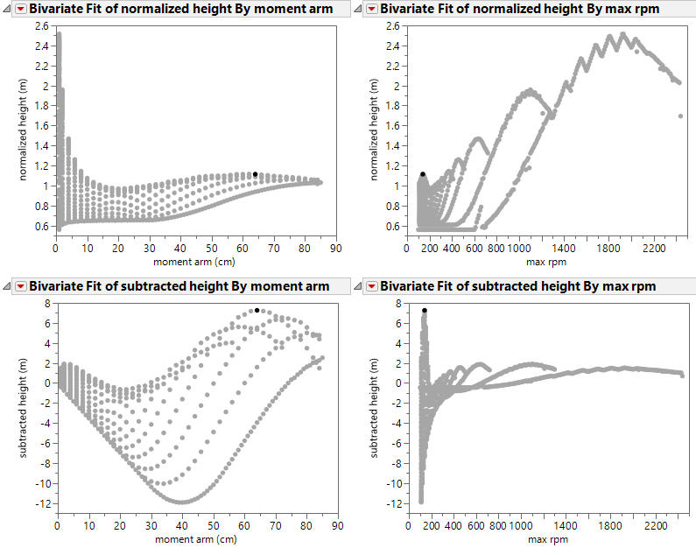
Simulation Unity
Iterate through lengths and gear ratios
Best gauge of height
Limit of moment arm length

Slide 6
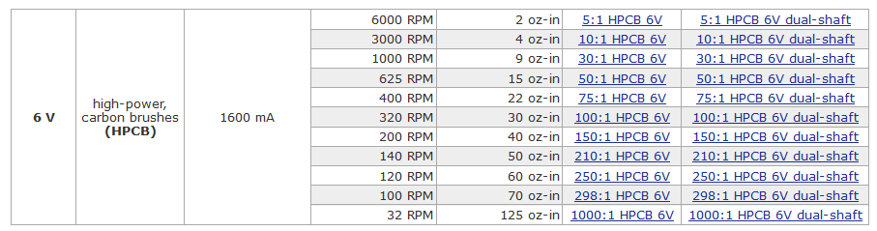
Motor

